Slide 1

Retail Banking Transaction Analysis

Slide 2
About me
Background : B.E(CSE)
Why you want to learn Data Science : I enjoy working with data and finding useful insights from it. I want to improve my skills in SQL, Python and EDA and build a career in Data Science.
Work Experience : Fresher
LinkedIn URLs : https://www.linkedin.com/in/manam-srikanth-949883285/
Git Hub profile URLs : https://github.com/manamsrikanth

Slide 3
Table of contents
Project Overview
Business Scenario
Business Objectives
Dataset & Database Overview
ER Diagram & Database Structure
Analysis of the Objectives
Overall Key Findings
Business Recommendations
Conclusion
Q&A

Slide 4
Project Overview
Project: Retail Banking Transaction Analysis.
Domain: Retail Banking.
Tool Used: MySQL.
Data: Customers, Accounts, Branches, Loans, Loan Payments, Cards and Transactions.
Database: Relational database with connected banking entities.
Goal: Analyze customer behavior, account activity, transactions, loans and card usage to generate meaningful business insights.

Slide 5
Business Scenario
A retail bank manages customer accounts, branches, loans, loan payments, cards and financial transactions across its operations.
The bank wants to:
Understand customer profiles and segments
Monitor account usage and branch activity
Analyze transaction patterns
Evaluate loan performance and repayment
Understand card usage and customer engagement
Use these insights to support better business decisions

Slide 6
Business Objectives
There are 5 major analytical objectives :
Customer Profile & Segmentation : Analyze customer demographics, income, credit score, KYC status and segments.
Account Usage & Branch Activity : Analyze account balances, account types, branch activity and account status.
Transaction Patterns : Analyze transaction types, channels, amounts and customer/account transaction behavior.
Loan Performance & Repayment : Analyze loan types, amounts, outstanding balances, statuses and repayment patterns.
Card Usage & Product Engagement : Analyze card types, credit limits, outstanding balances and reward points.

Slide 7
Dataset & Database Overview
Dataset Overview :
Customers — 500 records : Customer personal details, income, credit score, KYC status and customer segment.
Accounts — 700 records : Account type, balance, interest rate, status and customer/branch details.
Branches — 40 records : Branch name, location, region, opening date and employee count.
Loans — 300 records : Loan type, principal amount, interest rate, tenure, outstanding balance and status.
Loan Payments — 2,000 records : Payment amount, principal paid, interest paid, penalty, days late and payment method.
Cards — 600 records : Card type, credit limit, outstanding balance, reward points and card status.
Transactions — 5,000 records : Transaction type, amount, channel, date, time, status and balance information.
Database :
MySQL Relational Database
7 related tables
Primary Keys for unique identification
Foreign Keys for table relationships
Data analyzed using SQL queries

Slide 8
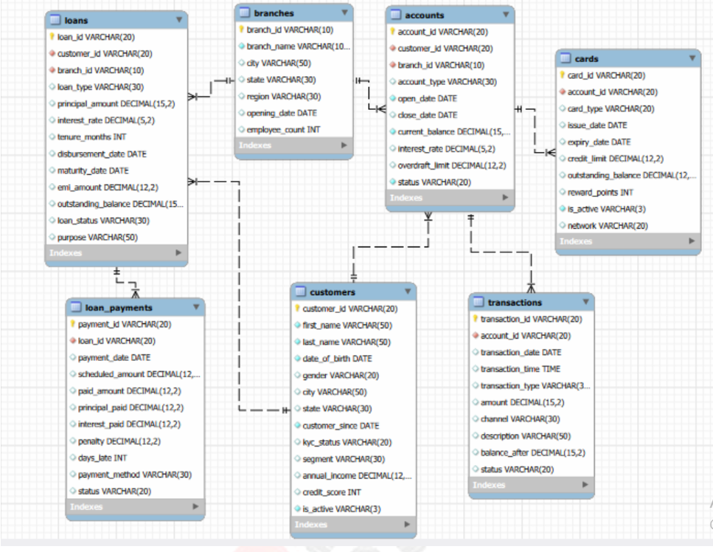
ER Diagram & Database Structure
Relationship explanation
1. Customers → Accounts: One customer can have multiple accounts.
2. Branches → Accounts: One branch can have multiple accounts.
3. Customers → Loans: One customer can have multiple loans.
4. Branches → Loans: One branch can have multiple loans.
5. Loans → Loan Payments: One loan can have multiple payments.
6. Accounts → Cards: One account can have multiple cards.
7. Accounts → Transactions: One account can have multiple transactions.

Slide 9
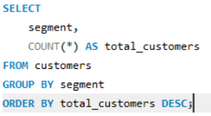
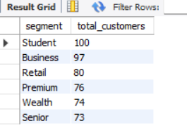
Analysis of the Objectives
Objective 4.1: Customer Profile & Segmentation
Objective : Understand the customer base and identify differences between customer groups.
Key Questions Analyzed:
1. Which customer segment has the most customers?

Slide 10
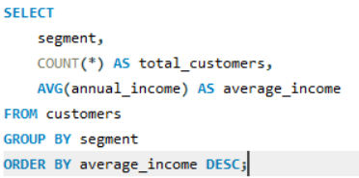
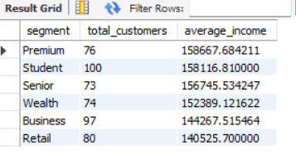
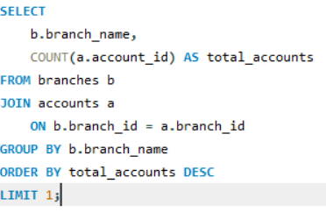

Analysis of the Objectives
2. Which customer segment has the highest average annual income?
3. Which branch has the highest number of accounts?

Slide 11
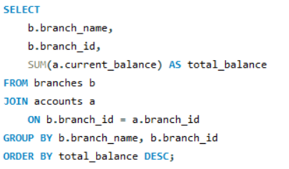
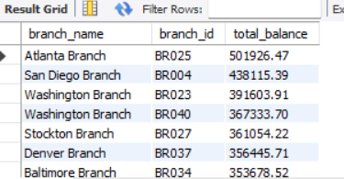
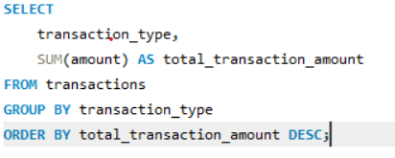
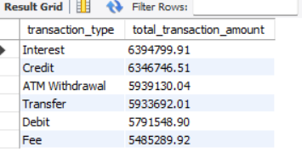
Analysis of the Objectives
4. Which branch has the highest total current account balance?
5. Which transaction type has the highest total transaction amount?

Slide 12
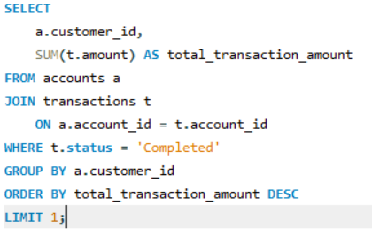

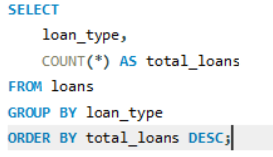
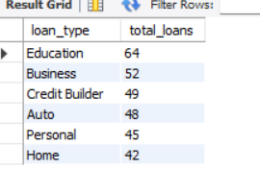
Analysis of the Objectives
6. Which customer has the highest total amount of completed transactions?
7. Which loan type has the highest number of loans?

Slide 13
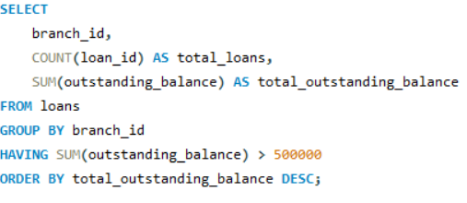
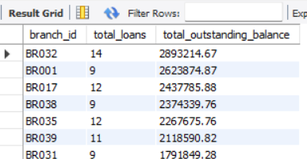
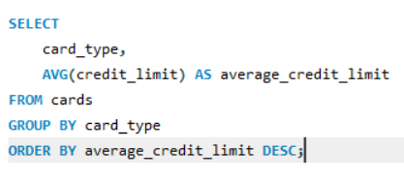
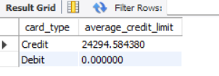
Analysis of the Objectives
8. Which branches have a total outstanding loan balance greater than ₹500,000?
9. Which card type has the highest average credit limit?

Slide 14
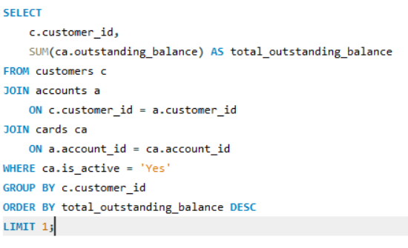

Analysis of the Objectives
10. Which customer has the highest total outstanding balance across active cards?

Slide 15
Overall Key Findings
Customer Profile: The bank can identify its most valuable customer segments using customer count, income, and credit-score patterns.
Account & Branch Activity: Jacksonville Branch leads in account volume with 67 accounts, showing strong customer presence.
Transaction Patterns: C000500 is a high-value customer, with ₹100,517.16 in completed transactions.
Loan Performance: Education loans are the most common, while Home loans have the highest average outstanding balance, indicating higher loan exposure.
Card Engagement: C000015 has the highest active-card outstanding balance of ₹33,836.91, indicating a customer requiring closer credit monitoring.

Slide 16
Business Recommendations
Customer Segmentation: Focus targeted marketing and premium products on high-value customer segments.
Branch Activity: Strengthen Jacksonville and Atlanta branches through customer retention and cross-selling opportunities, based on their strong account activity and balances.
Digital Transactions: Promote and improve Online and Mobile banking, as these channels handle relatively higher-value transactions.
Loan Risk Management: Closely monitor branches with high outstanding loan balances, especially Louisville Branch, to improve recovery and control credit risk.
Card Risk Management: Monitor customers with high card outstanding balances and provide suitable repayment or credit-management support.

Slide 17
Conclusion
The Retail Banking Data Analytics project demonstrates how SQL can be used to analyze real-world banking data in a structured and meaningful way.
The project covers the complete process from understanding the business problem and designing the database to analyzing the data and generating insights.
By analyzing customers, accounts, transactions, cards, loans, and loan payments together, the project provides a broader understanding of banking operations and customer activity.
Overall, the project shows how data analysis can help transform raw banking data into useful information for better business decisions.

Slide 18

THANK YOU

